Slide 1

SYSTEM DESIGN
Md Minhajul Abedin, CTO, BracIT

Slide 2

What is a System?
A system is a group of interacting or interrelated elements that act according to a set of rules to form a unified whole. A system, surrounded and influenced by its environment, is described by its boundaries, structure and purpose and is expressed in its functioning. Systems are the subjects of study of systems theory and other systems sciences.
Systems have several common properties and characteristics, including structure, function(s), behavior and interconnectivity.

Slide 3

Software Systems
Most modern Software is not just a piece of Desktop or Web or Mobile Application
Due to the business need it has become an urgent topic for people directly involved in building Software.
Systems thinking can improve the ability to collect requirements, design implementation plan, assuring quality and successful delivery.

Slide 4

Systems Thinking in Software Development
Systems thinking in software development means looking at the big picture and understanding how different parts of a system interact with each other. It helps developers make effective changes and solve problems by considering the whole system, not just individual components.

Slide 5

Systems Thinking
Systems have purpose.
All parts must be present for a system to carry out its purpose optimally.
The order in which the parts are arranged affects the performance of a system.
Systems attempt to maintain stability through feedback.

Slide 6
Tools for Systems Thinking
Diagram & Visualization
Mind map
Flow Charts
Causal Loop
Quantifying
Data Collection Tools
Event Analysis
Modeling

Slide 7
PEDALS Framework: Software System Design
Process Requirements
Estimate
Design the Service
Articulate Data Model
List Architectural Components
Scale

Slide 8
P rocess Requirements
What is the Software all about?
What features does it include?
How does it work?
What are the goals or outcomes?
What are the constraints?
What are the expectations for the future?
How does it talk to other systems? (if necessary)
Is there any policy or compliance to follow?
Uptime?

Slide 9
E stimate
Number of total users.
Number of active users.
Request per second(RPS).
Transactions per second (TPS, if it’s a financial solution).
Possibility of Surge and its details.
Login per second.
Search per second/ Events per second
Storage Volume & functionality of storage.

Slide 10
D esign the Service
Information Processing Strategies
Rate Limiting Strategies
Communication Strategies
Latency Strategies
Efficiency Strategies
Space Reduction Strategies
Synchronization Strategies
Error Handling Strategies
Security Strategies
Code Maintainability Stratigies

Slide 11
A rticulate the Data Model
SQL VS NoSQL
Caching / In memory Data
RDBMS Principles
Data Sync Standards
Non Database Storage
Object Storage

Slide 12
L ist the Architectural Components
Logical Architecture
Physical Architecture
Cloud Architecture
Load Balancer
Cache Service/ CDN
API Gateway
Service Bus
Message Queue
Authentication & Authorization
Service Platform (Server/Serverless)
DB Cluster
Storage Engine

Slide 13
S cale
Handling More Users
More Requests
More Data Read
Providing Improved Latency
Crash free Operations
Data Consistency
High Availability

Slide 14
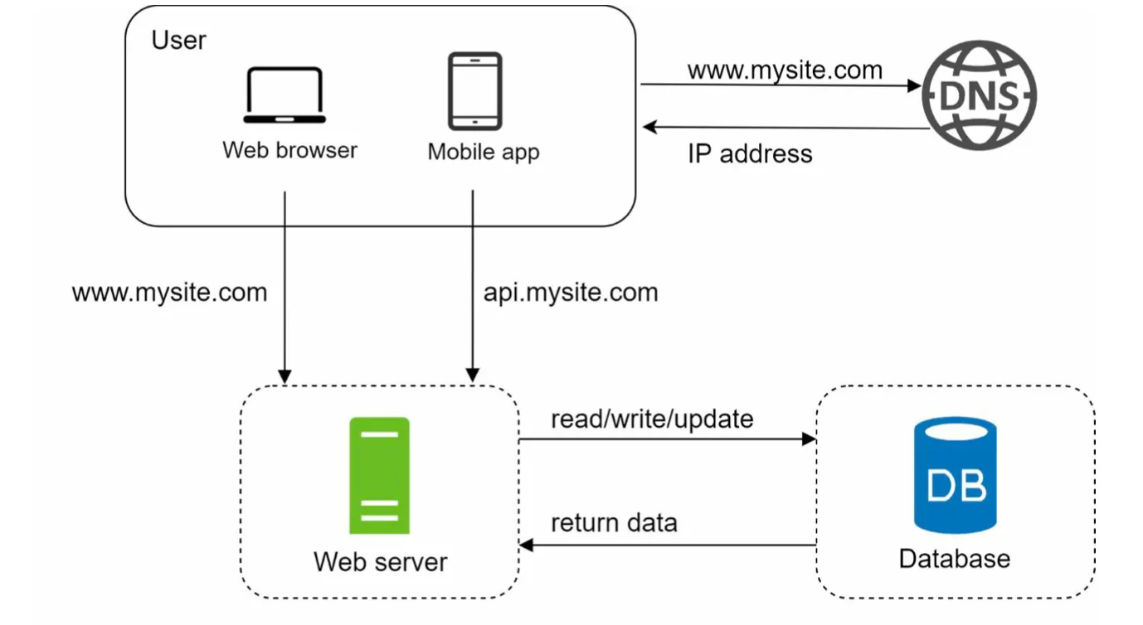
Can handle 1000 users
Concurrent user < 100
Completely Monolithic
No Load Balancer
No Microservice
No Caching
No Message Queue
No DB Replica
Monitoring Stack: Simple Log is enough

Slide 15
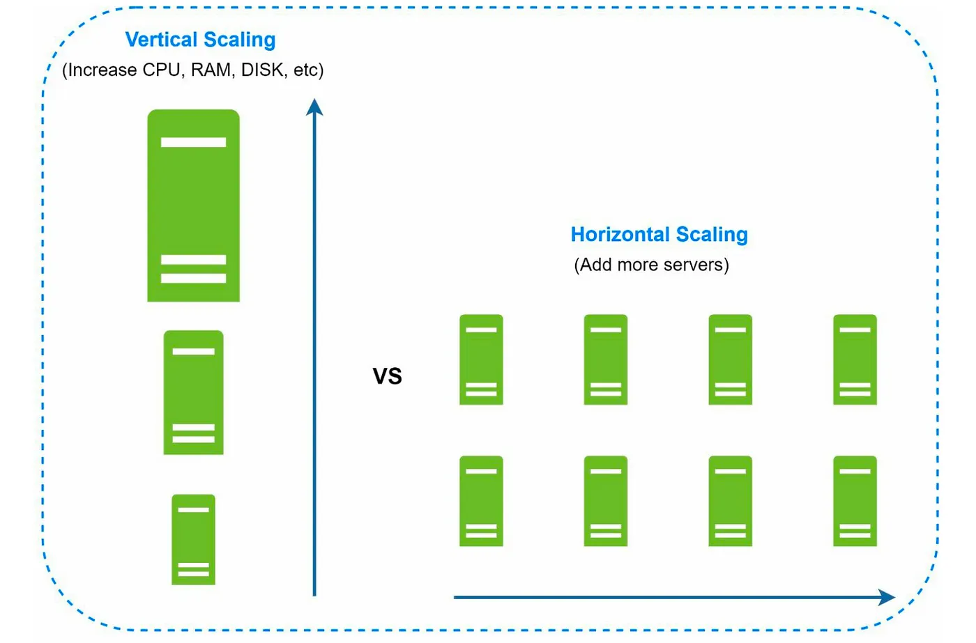

Slide 16
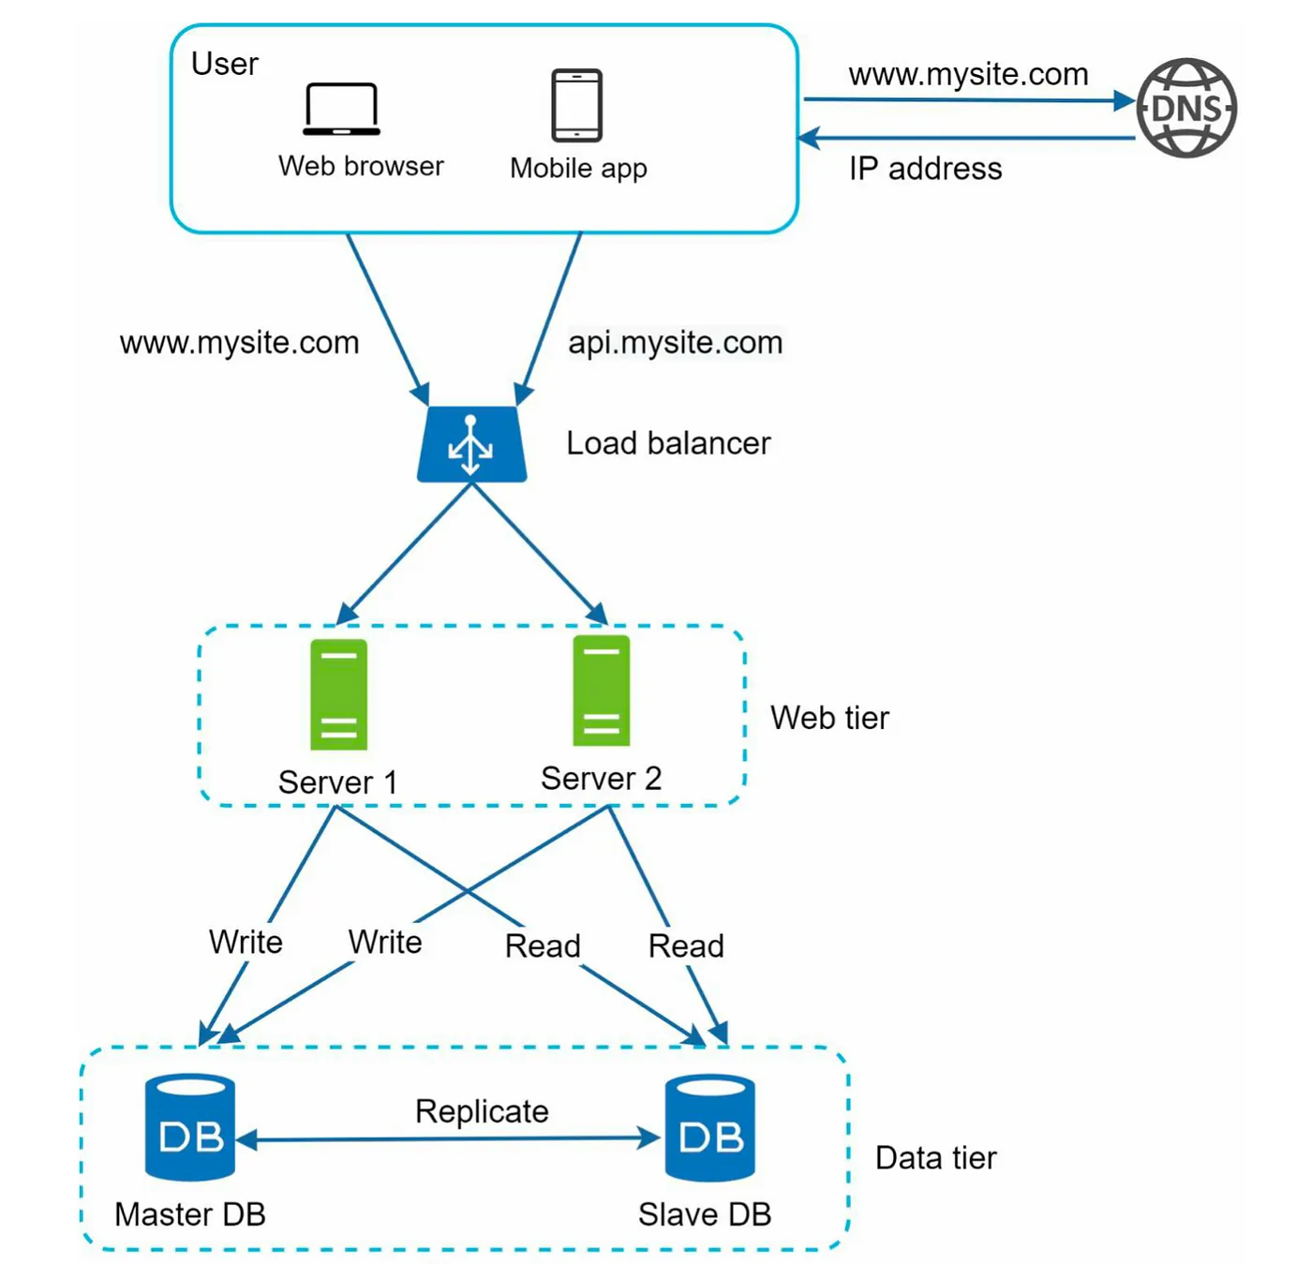
Can handle 10,000 users
Concurrent user < 1000
Completely Monolithic (either stateless or sticky LB)
1 Load Balancer
No Microservice
No Caching
No Message Queue
Master Slave DB
Monitoring Stack: Good to have

Slide 17
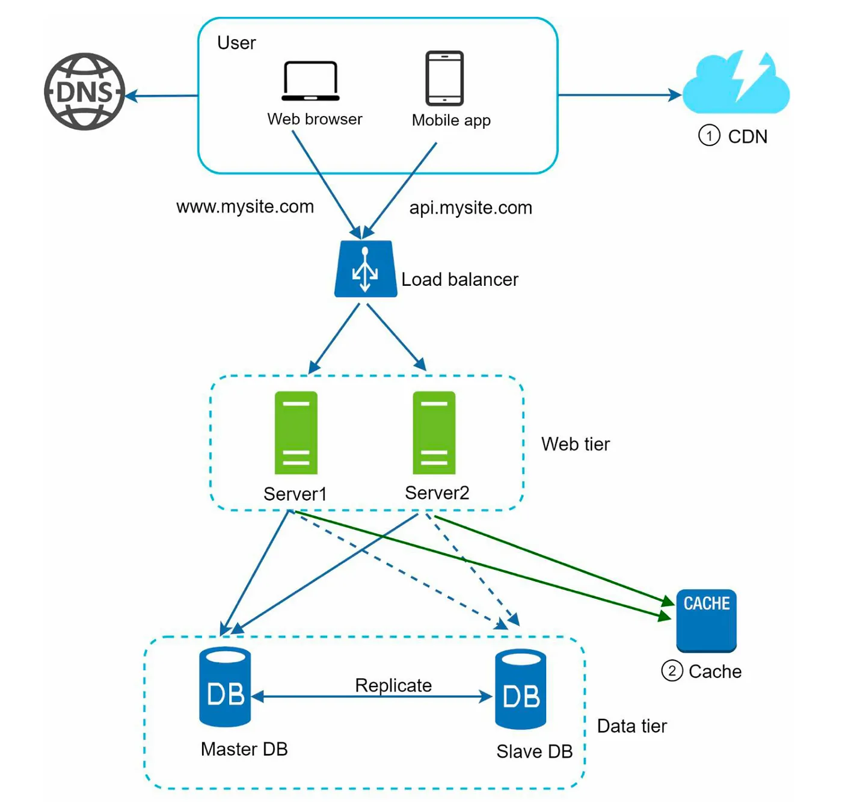
Can handle 10,000 users
Concurrent user < 1000
Concurrent Read User ~= 5K
Completely Monolithic (either stateless or sticky LB)
Load Balancer Present
No Microservice
Caching & CDN Enabled
No Message Queue
Master Slave DB
Monitoring Stack:Good to have

Slide 18
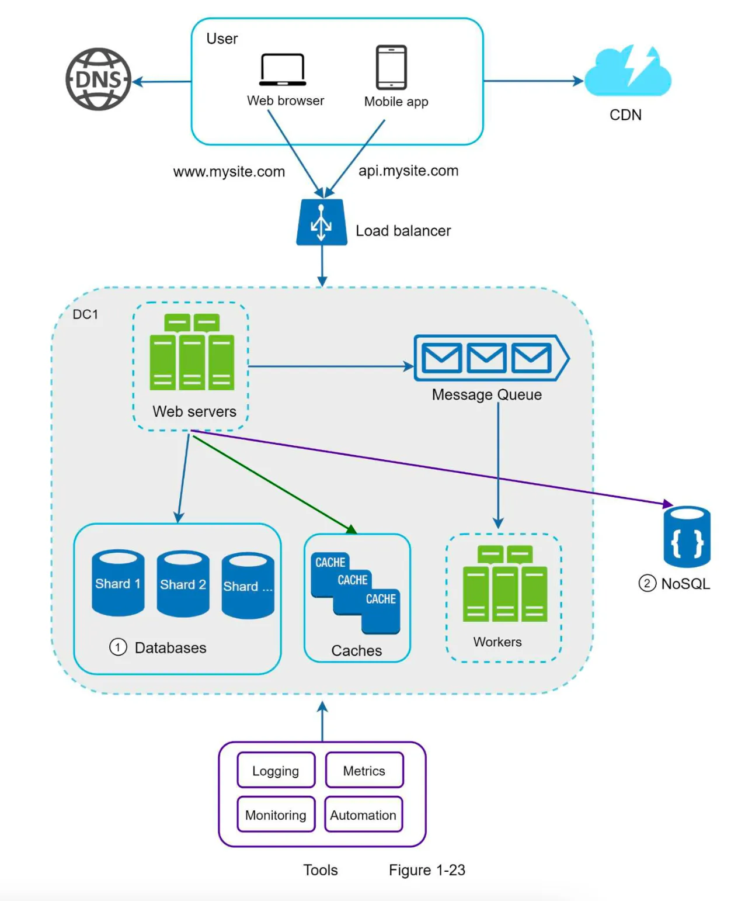
Can handle 50,000 users
Concurrent user < 10,000
Concurrent Read User ~= 50K
Hybrid Services or SOA
(either stateless or sticky LB)
Load Balancer Present
No Microservice
Caching & CDN Enabled
Message Queue for Async Tasks
Master Slave DB
Monitoring Stack: Must Have

Slide 19
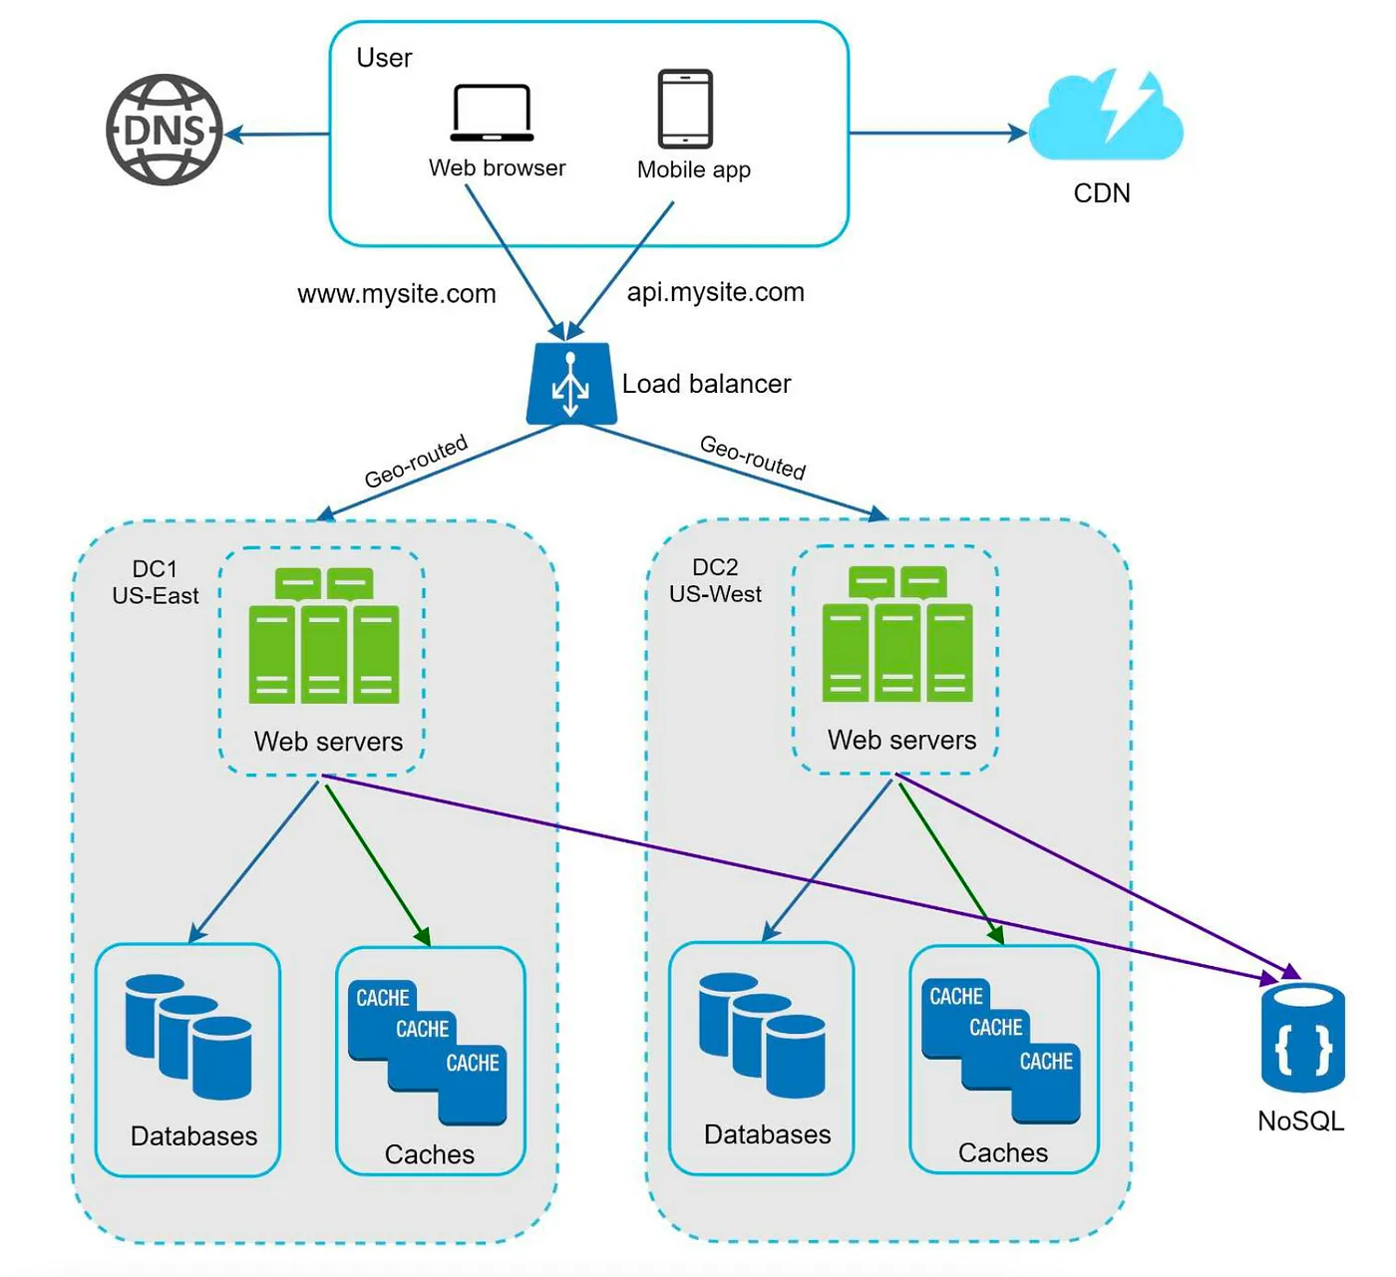
Can handle 50,000++ users
Multi Region Concurrent user < 10,000
Concurrent Read User ~= 50K
Hybrid Services or SOA
(either stateless or sticky LB)
Load Balancer Present
No Microservice
Caching & CDN Enabled
Message Queue for Async Tasks
Master Slave DB
Monitoring Stack: Must Have

Slide 20
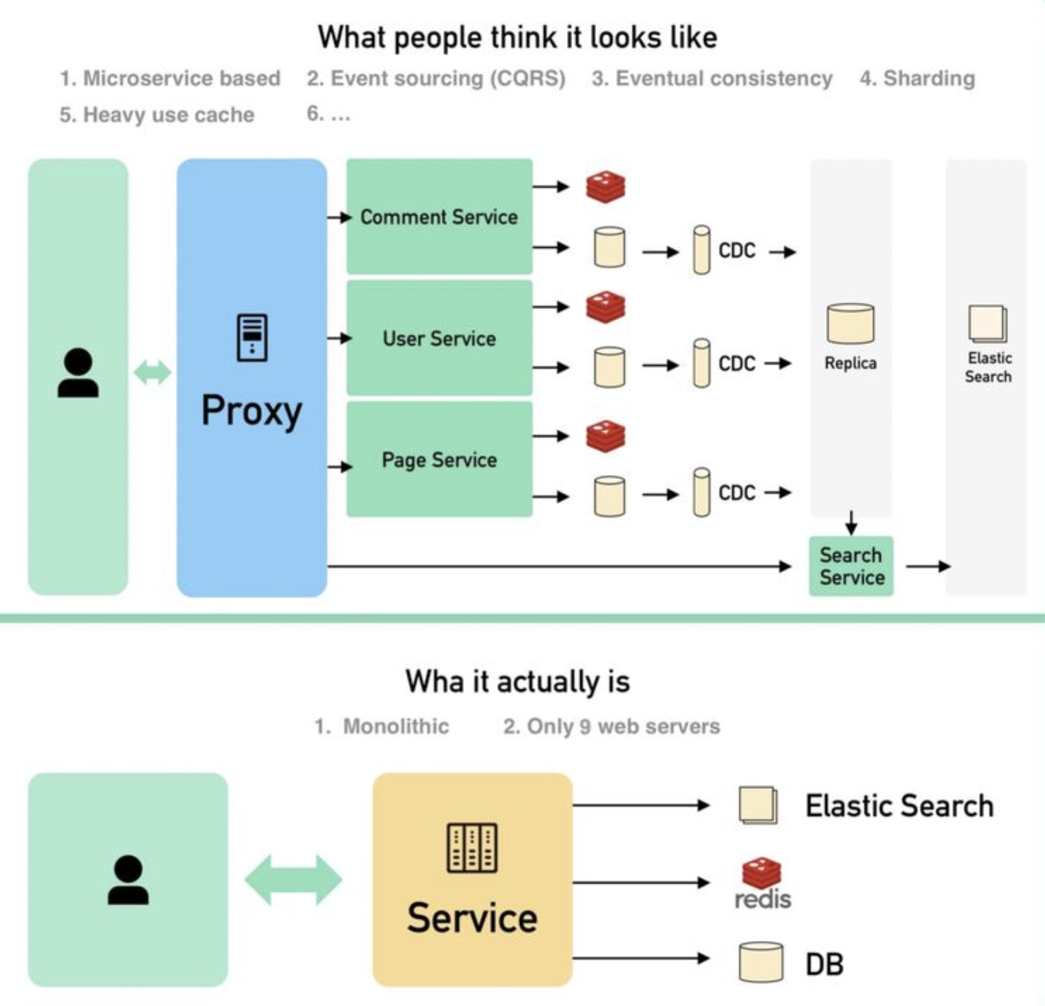
Stack Overflow Architecture

Slide 21
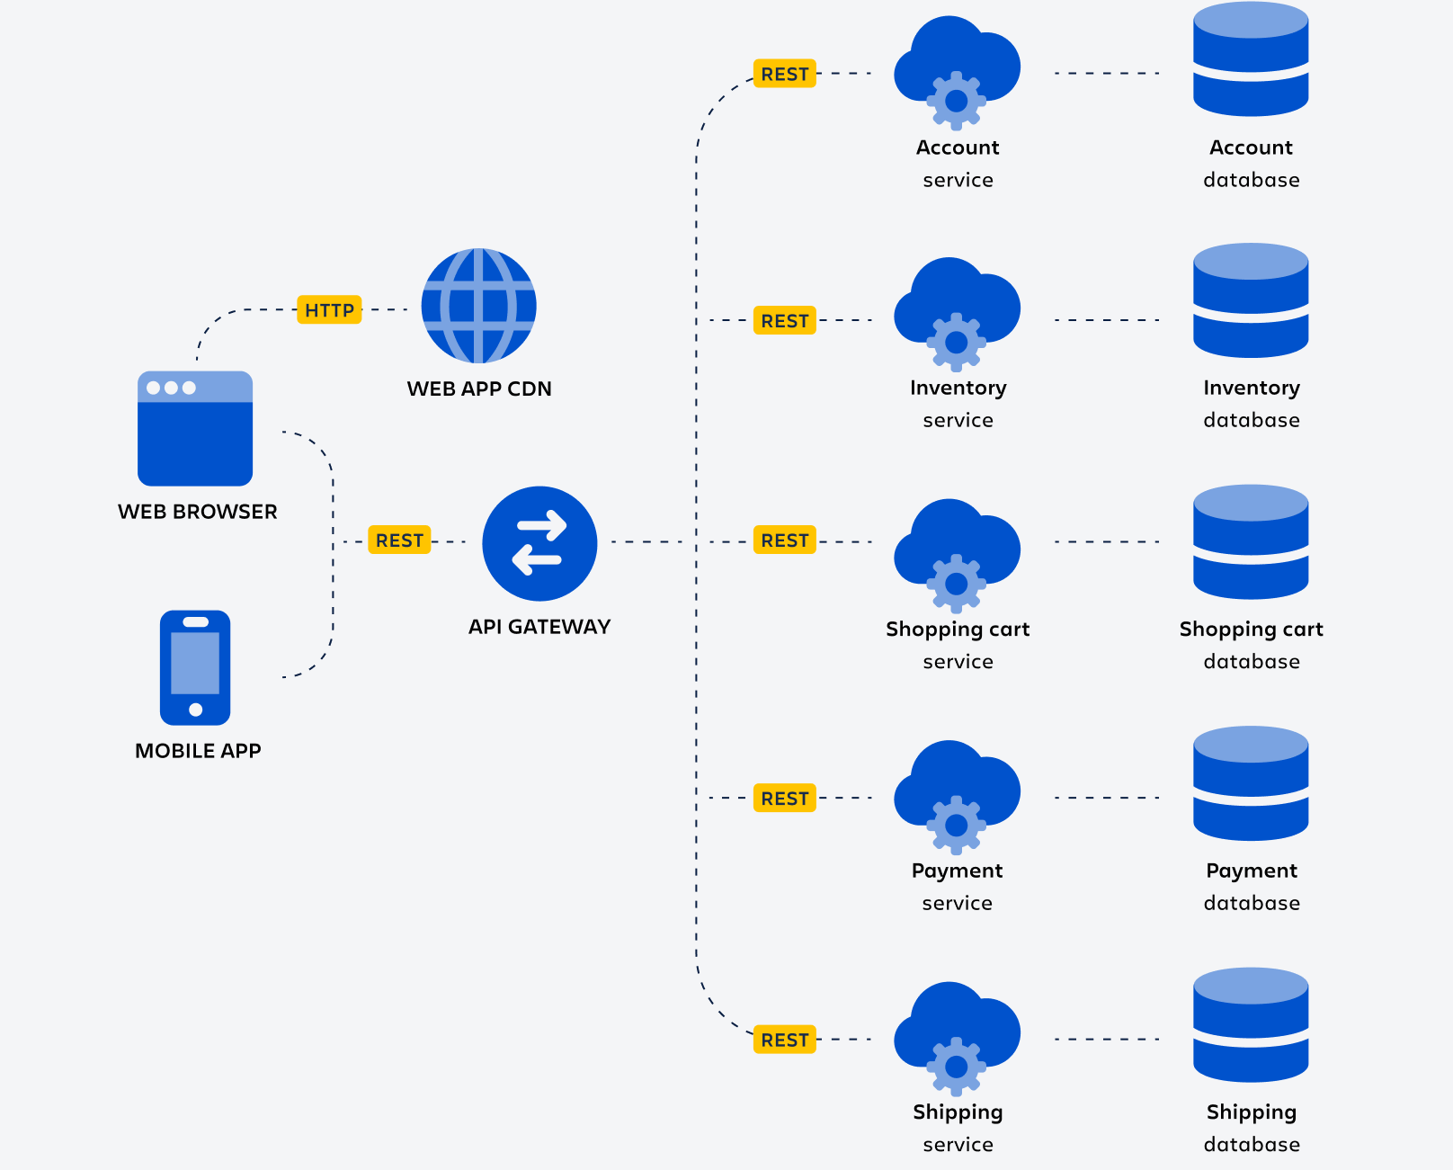

প্যারাসিটামল
২ বেলা

Slide 22
Exercise
Design an Athlete Management System
Store and update profiles of all Cricketers (can be extended for any other type of athlete)
Keep track of their fitness (Quick access, easy operations)
Athletes can check their schedules and can interact online.
Keep track of their injuries & treatment, including recovery plan and progress. (Physios of the BCB should have a good UX)
Keep track of their practice schedules (assign, notify, interact)
Selectors & Coaches can have access to summary & detailed data
There are teams, groups, camps – both long term & short term
Mobile App should work offline but sync data while online (not sync data should be clearly distinguishable in the UI)

Slide 23
Questions?

Slide 24
Thank You

